Slide 1

Tutorial: Beginning FHIR Shorthand
Mark Kramer
Chief Engineer for Health Technical Center
Chris Moesel
Principal Software Systems Engineer
MITRE Corporation
May, 2020

Slide 2

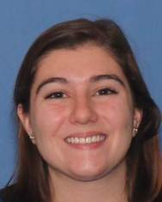



FHIR Shorthand and SUSHI Team
Chris Moesel
Julia Afeltra
Nick Freiter
Mint Thompson
Mark Kramer

Slide 3









MITRE is a US non-profit whose mission-driven teams are dedicated to solving problems for a safer world.
Through our federally funded R&D centers and public-private partnerships, we work across US government to tackle challenges to the safety, stability, and well-being of our nation.
Standard Health Record for Oncology
Crucible

Slide 4
Motivation: Accelerating the IG Authoring Process
Initial requirements
Exploration of design options
Connectathon feedback
Experience from pilot projects
Ballot comments received
Evolution of FHIR
Additional stakeholders join project
Changes in scope
Better understanding of the domain
Alignment with related standards
Changes to related IGs
Input from sponsoring WG
⇨ Many iterations
⇨ Need for agility

Slide 5
What is FHIR Shorthand?
A domain-specific language (DSL) designed for profiling and IG creation
Formal grammar (ANTLR4)
Reference implementation compiler (SUSHI)
Concise, understandable, and aligned to user intentions
FSH representation is more understandable than a StructureDefinition (by far)
Concise way to store and exchange profiles (10s of lines versus 1000s lines)
Ideal for collaborative development under source code control
Meaningful version-to-version differentials
Support for merging and conflict resolution
Refactoring through global search/replace operations
Tools can be built on top of FSH language
e.g., FSH Food, importer from StructureDefinitions to FSH

Slide 6
Who is the target user for FSH?
FSH is not point and click
Users must be self-guided
Programming skills or similar mindset
Source code, compiling, inputs, outputs, etc.
File management, source code control
Familiarity with FHIR required
Resources, profiles, extensions
StructureDefinitions (a little)
IG Publisher

Slide 7

What's Up With All the Fish Puns?
FHIR®
S
h rt
™
→ .fsh file type
"Shorty"
SUSHI Compiler : “SUSHI Unshortens Short Hand Inputs”

Slide 8


What do you call a FISH with no eyes?

Slide 9
What do you call a FISH with no eyes?
FSH !

Slide 10





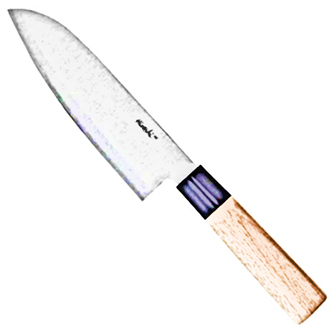


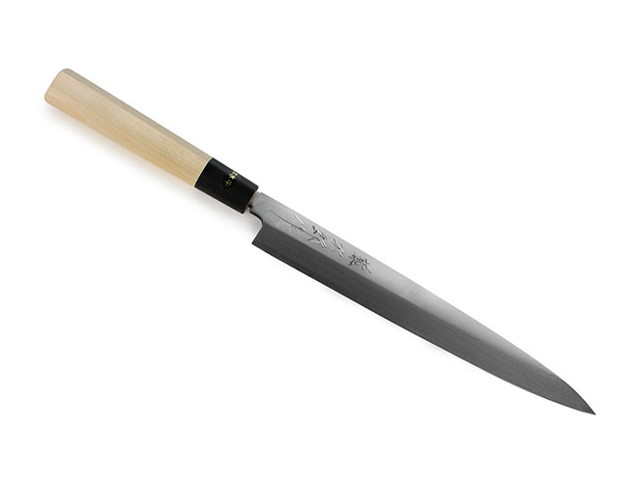
Overall Workflow with SUSHI and IG Publisher
Project "FSH Tank"
FSH files
SUSHI Compiler
Profiles
Extensions
FHIR IG
Publisher
Instances
Value Sets
Pages, Images, Menus
Additional Content for IG
Implementation Guide

Slide 11

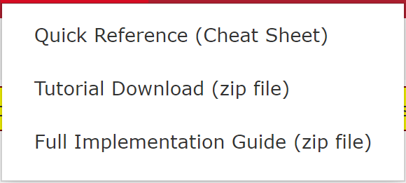
FHIR Shorthand Language
Documentation:
http://build.fhir.org/ig/HL7/fhir-shorthand/ -- Current version
http://hl7.org/fhir/uv/shorthand/2020May/ -- Ballot version

Slide 12
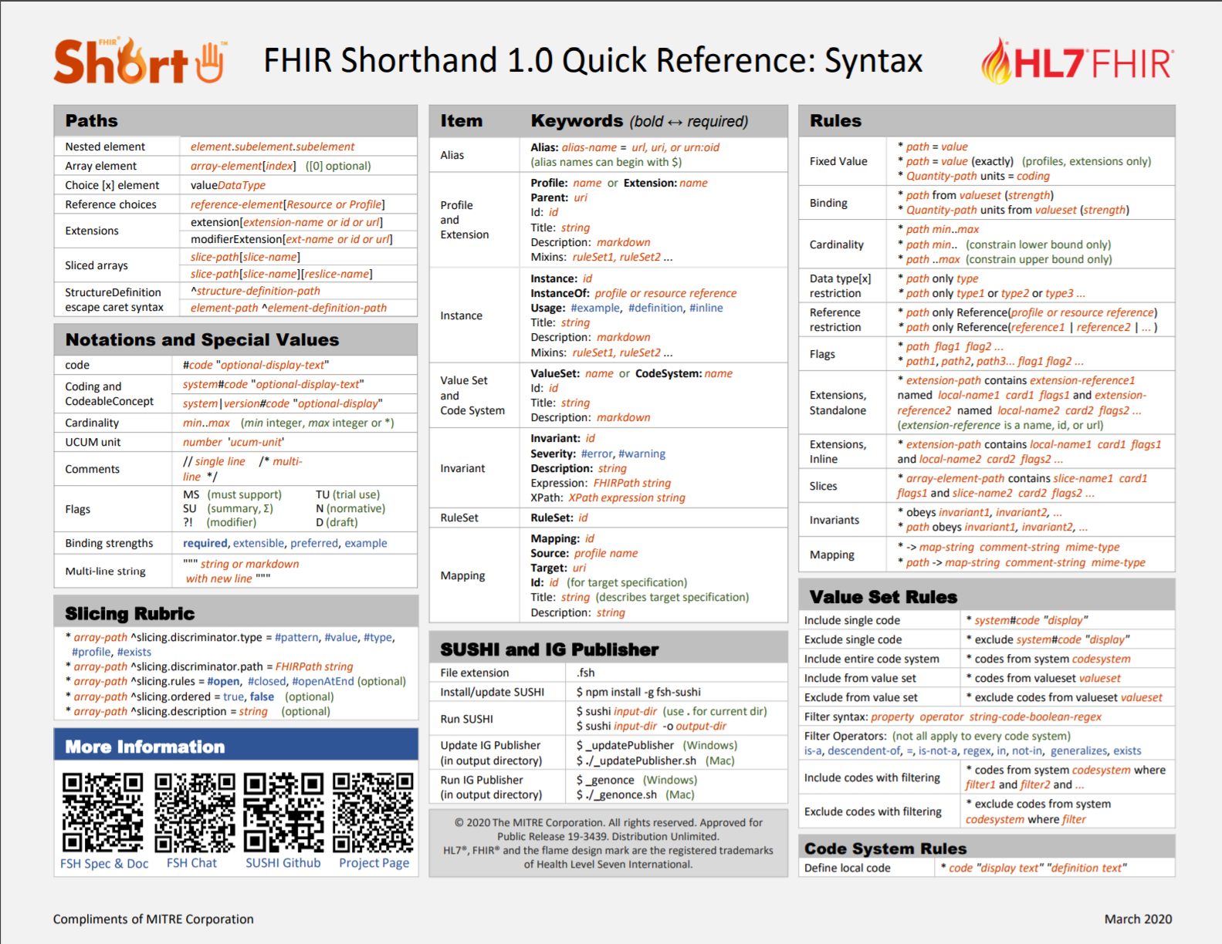
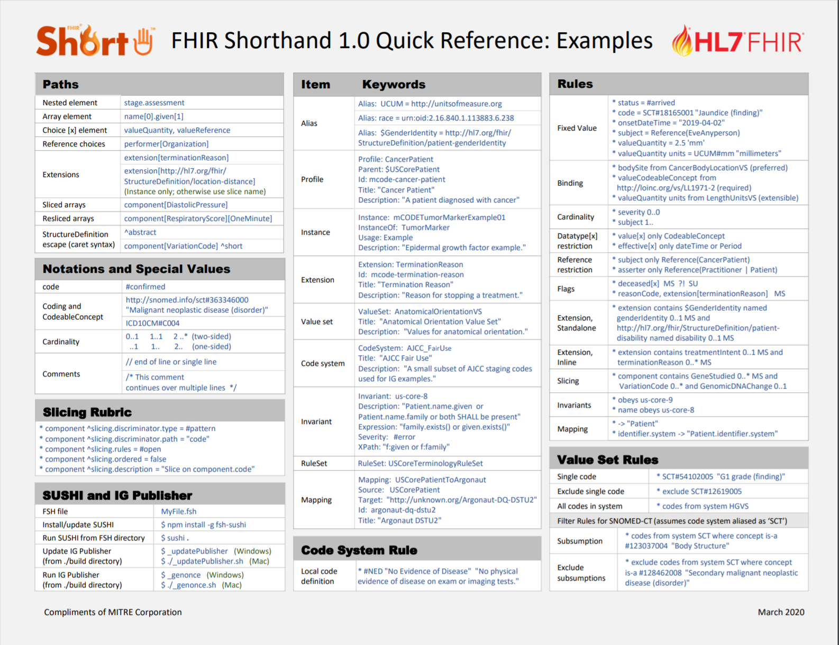
Quick Reference Card
Patterns
Examples

Slide 13
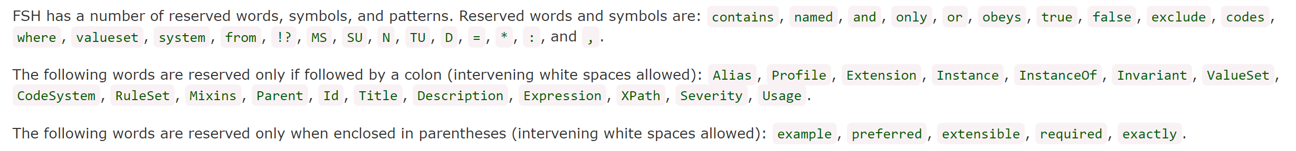
Basics
FHIR R4 (4.0.1)
Primitive data types -- same as FHIR
Files -- end in .fsh
Everything in one file, one item per file, or anywhere inbetween
Whitespace -- repeated whitespace ignored
Comments
// single line comment
/* multiple
line comment */
Reserved words and symbols

Slide 14
Alias Statements
You can alias any url, urn, or oid
Only for readability -- does not affect functionality
Usually alias statements appear at the top of a file
Must be defined outside of profiles or other items
Aliases are global within a project
Alias names can begin with $ (assists with error checking)
* Alias: SCT = http://snomed.info/sct
* Alias: LNC = http://loinc.org
* Alias: $RACE = urn:oid:2.16.840.1.113883.6.238
* Alias: USCorePatient = http://hl7.org/fhir/us/core/StructureDefinition/us-core-patient

Slide 15
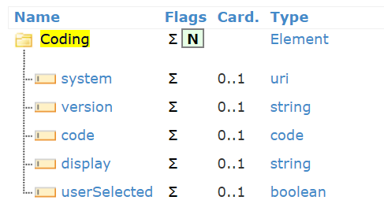
Coded Data Types
Code:
#{code}
#"{code}"
Examples:
#confirmed
#398457
Coding:
{system}|{version}#{code} "{display}"
Examples:
http://snomed.info/sct#363346000 "Malignant neoplastic disease (disorder)
SCT#363346000 "Malignant neoplastic disease (disorder)" // Same, but with Alias
ICD10CM#C004
optional

Slide 16
Paths: Referring to Elements
Top-level element:
severity
bodySite
abatement[x]
abatementAge
Nested path:
bodySite.text
dosage.doseAndRate.doseQuantity.value
Array path (zero-based)
bodySite.coding[0]
contact[1].telecom[0]
name[0].given[1]

Slide 17
Paths for Choices and Slices
Choices
generalPractitioner[Organization]
generalPractitioner[PractitionerRole]
Extensions and Sliced Arrays
Use the slice or extension name or URL in brackets:
extension[race]
extension[http://hl7.org/fhir/us/core/StructureDefinition/us-core-race]
component[SystolicBP]
component[DiastolicBP]
generalPractitioner |  |  | Reference(Organization | Practitioner | PractitionerRole)

Slide 18
More Path Examples
Combining nested paths with array elements:
bodySite.coding[0].display
contact[1].telecom[0].rank
Path into a slice of Observation.component:
component[SystolicBP].valueQuantity.value
Path into a complex extension:
extension[race].extension[ombCategory].valueCoding.system
Illegal path crossing resource boundary from Patient to Organization:
generalPractitioner[Organization].name

Slide 19
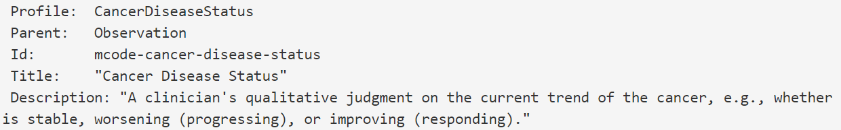
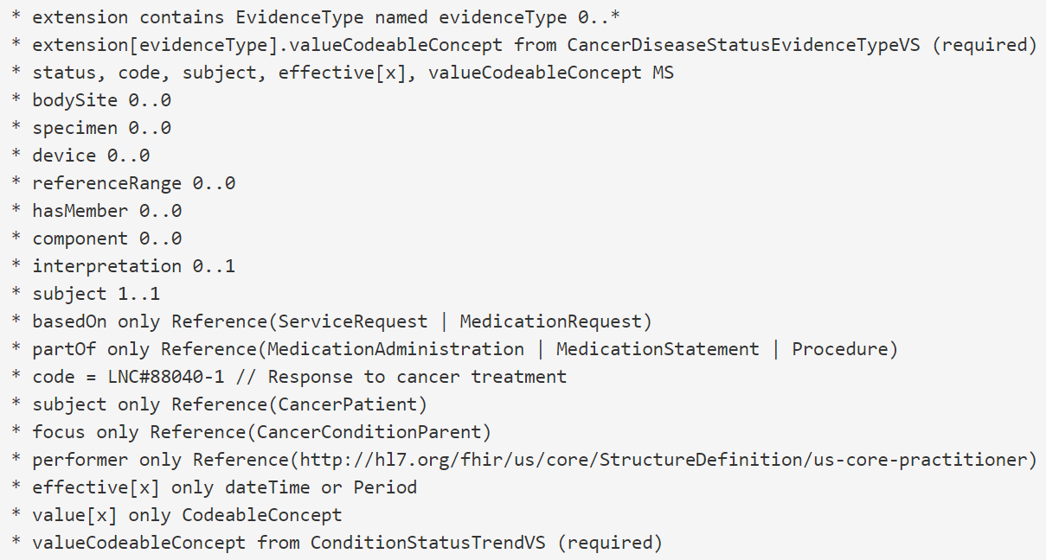
Creating a Profile
Item Type & Name
Keywords
Rules

Slide 20
Profile Keywords
Profile: {name}
Id: {id} // optional, defaults to name
Parent: {profile name, resource name, or url}
Title: {string}
Description: {string or markdown}
Mixins: {mixin1 name}, {mixin2 name}, ...
Possible Parents:
Resource (e.g., Patient, Observation)
A profile defined in the current project
Profile from another IG declared as a dependency in IG resource (e.g., http://hl7.org/fhir/us/core/StructureDefinition/us-core-patient)

Slide 21
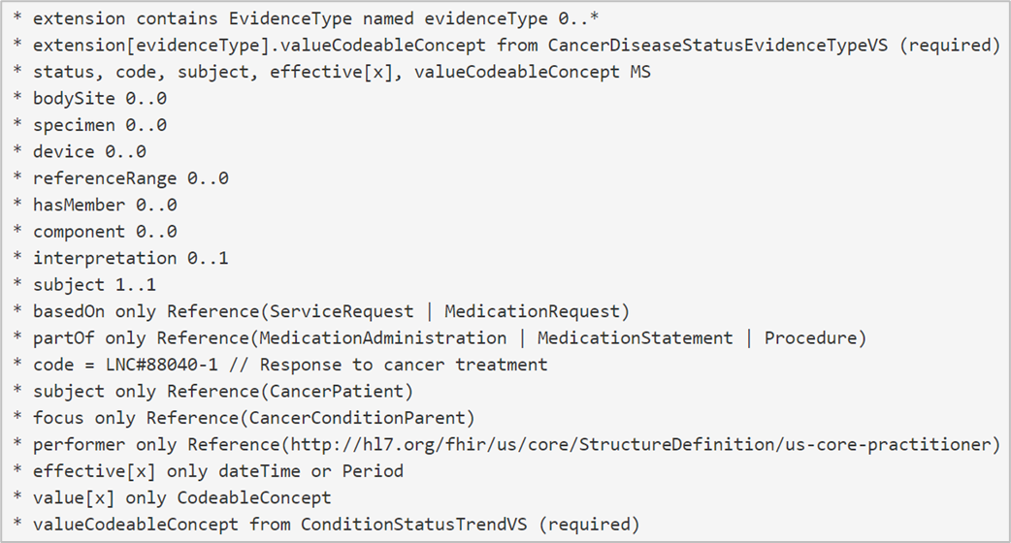
Line-By-Line Walkthough
Rule order usually doesn't matter
However, an extension or slice must exist before it is referred to by other rules

Slide 22
Flags and Cardinality
Must Support. Other flags include SU (Summary), ?! (Modifier), N (Normative), TU (Trial Use), D (Draft).
Restrict cardinality. Must be equal or tighter than cardinality in parent.
(Currently you can't combine onto a single line)

Slide 23
The "only" keyword
Restrict choice using "only". Vertical bars for remaining choices.
You can also restrict choices to profiles on the original types (e.g., Patient → CancerPatient)
The "only" keyword is also used for datatype choices [x]
Note: "or" versus "|"

Slide 24
Restricting Values
Equals sign (=) is used to set most type of values (strings, quantities, dates and times, booleans, codings, etc.)
"from" is used to indicate a coded value must come from a value set. The modifiers are the same as FHIR (required, extensible, preferred, example):

Slide 25
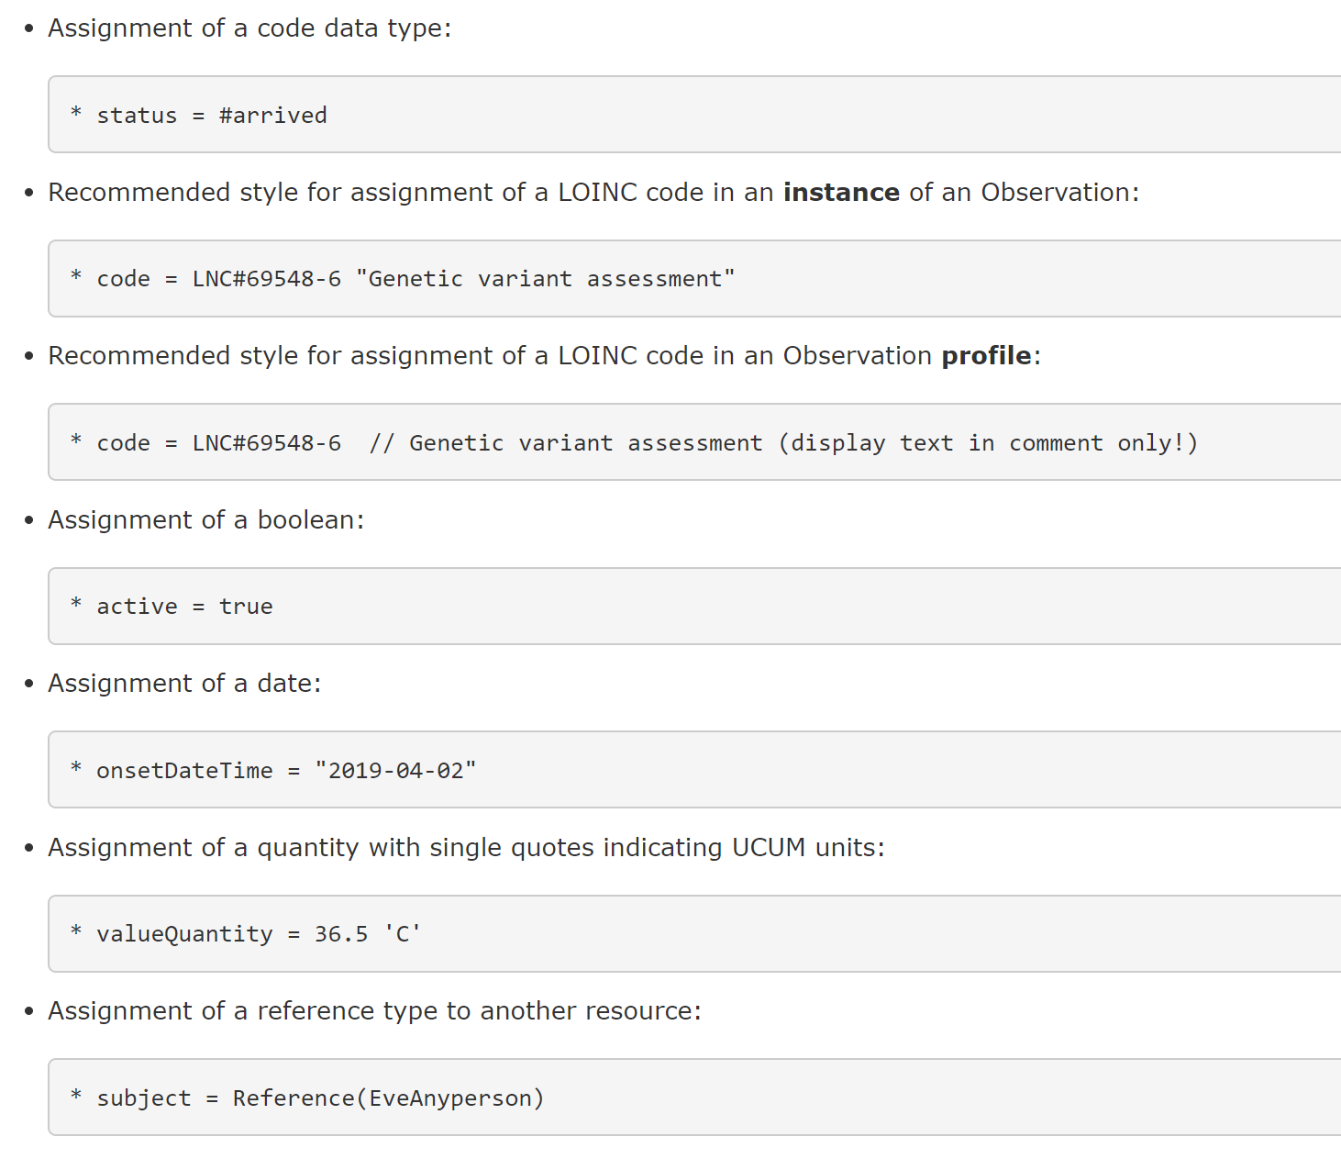
Fixed Value Rule Examples

Slide 26
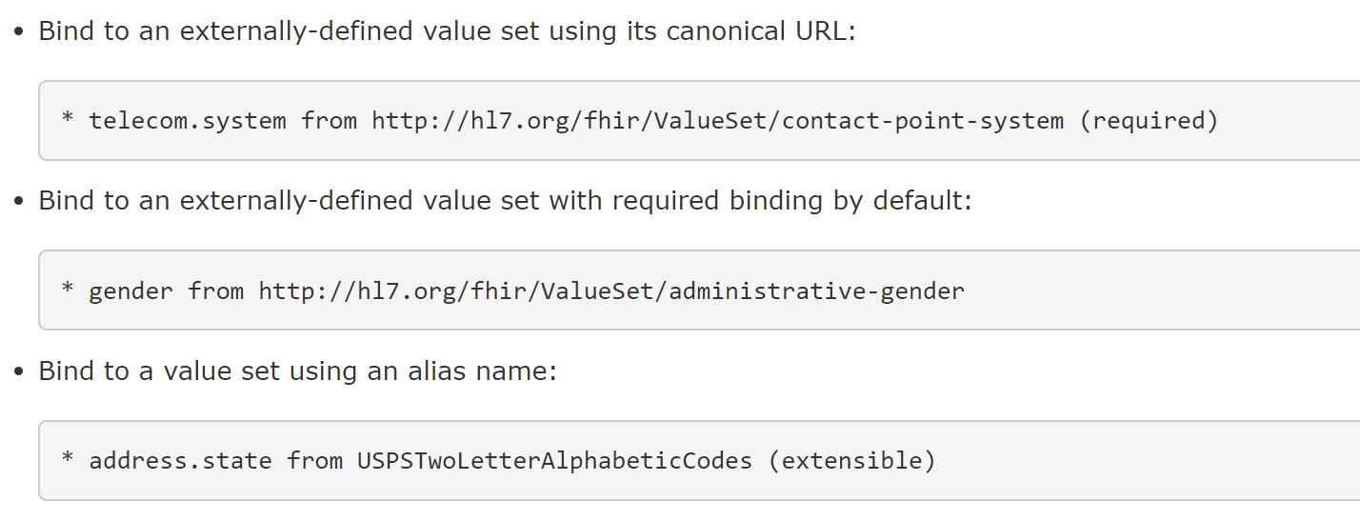
Binding Rule Examples

Slide 27
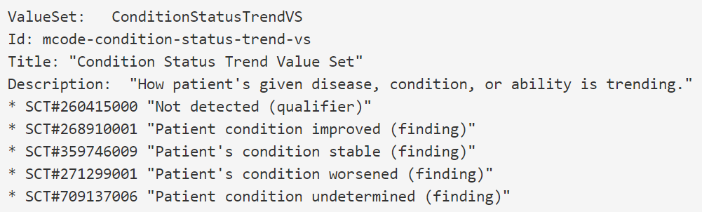
Value Set Example
An extensional value set contains an explicit list of codes
The extensional form is very simple: * {coding}

Slide 28
Value Set Rules
Rule to include/exclude a single code:
* SCT#54102005 "G1 grade (finding)"
* exclude SCT#54102005 "G1 grade (finding)"
Rule to include/exclude an entire value set:
* codes from valueset http://hl7.org/fhir/ValueSet/bodysite-laterality
* exclude codes from valueset http://hl7.org/fhir/ValueSet/bodysite-laterality
Rule to include/exclude an entire code system:
* codes from system http://hl7.org/fhir/ndfrt
* exclude codes from system http://hl7.org/fhir/ndfrt

Slide 29
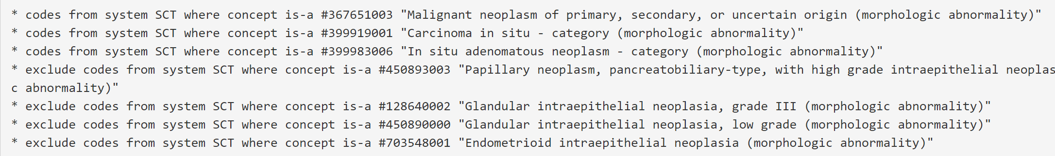
Value Set Filtering Rules
Rules can contain filter expressions that modify the codes to be included/excluded
Syntax of filters depends on the particular vocabulary
e.g., ICD-10 filters are not the same as SNOMED-CT filters
Here are examples for SNOMED-CT (aliased to SCT):

Slide 30
Code Systems
It should be rarely necessary to define a new code system (a last resort)
The rule syntax is: * #{code} {display string} {definition string}
CodeSystem: YogaCS
Title: "Yoga Code System"
Description: "A brief vocabulary of yoga-related terms."
* #Sirsasana "Headstand"
"An inverted asana, also called mudra in classical hatha yoga, involves standing on one's head."
* #Halasana "Plough Pose"
"Halasana or Plough pose is an inverted asana in hatha yoga and modern yoga as exercise. Its variations include Karnapidasana with the knees by the ears, and Supta Konasana with the feet wide apart."
* #Matsyasana "Fish Pose"
"Matsyasana is a reclining back-bending asana in hatha yoga and modern yoga as exercise. It is commonly considered a counterasana to Sarvangasana, or shoulder stand, specifically within the context of the Ashtanga Vinyasa Yoga Primary Series."
* #Bhujangasana "Cobra Pose"
"Bhujangasana, or Cobra Pose is a reclining back-bending asana in hatha yoga and modern yoga as exercise. It is commonly performed in a cycle of asanas in Surya Namaskar (Salute to the Sun) as an alternative to Urdhva Mukha Svanasana (Upwards Dog Pose)."

Slide 31
Instances
IGs contain instances for several purposes:
Examples - instances that illustrate how to use a profile, presented on the Examples tab for the corresponding profile
Definitions - conformance items that are instances of resources such as search parameter, operation definition, or questionnaire
Inline - instances that should not be instantiated as an independent resource, but appears as part of another instance (for example, in a composition or bundle)
Instances are defined in FSH using the "Instance" keyword
"InstanceOf" instead of "Parent"
Structures and values are inherited from the StructureDefinition (i.e. fixed codes, extensions)

Slide 32
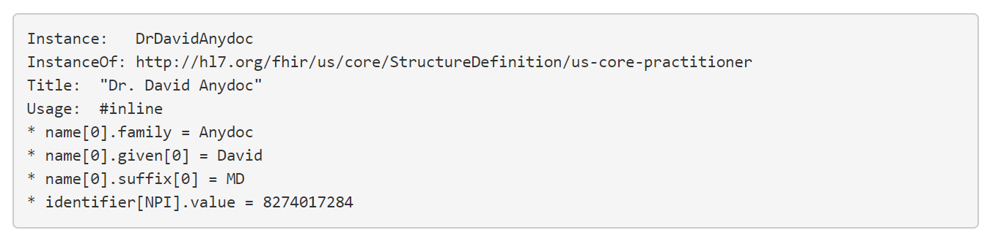
Instance Example
Instances will use fixed value rules, because instances have specific values
Instances will not use cardinality, flag, "only", "from", or "contains" rules

Slide 33
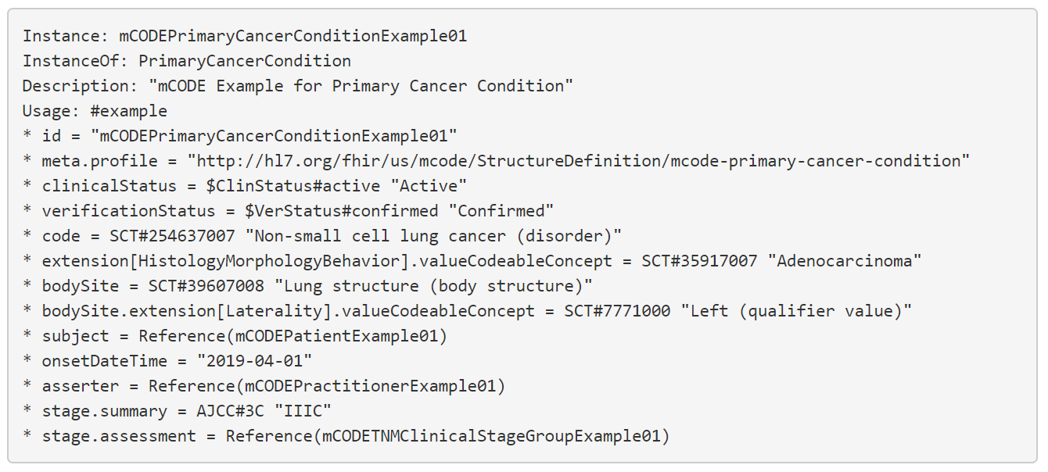
More Complex Instance Example

Slide 34
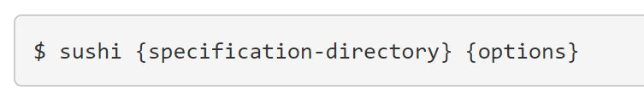
Executing SUSHI
($ is command prompt)
Sushi translates FSH files into FHIR artifacts
Simplest version of the sushi command, if current directory contains FSH files:
$ sushi .
A common option is
-o {output directory}
Let's talk about sushi inputs and outputs...

Slide 35
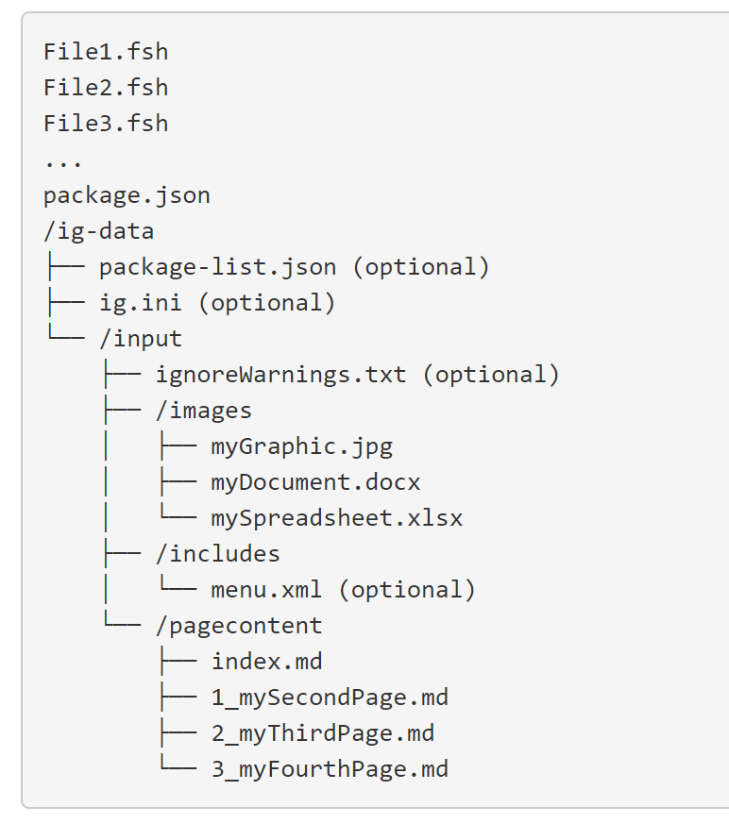
SUSHI Inputs
IG Configuration Files:
package.json: This required file is the package manifest. The content is described here.
package-list.json: This optional file, described here, should contain the version history of your IG. If present, it will be used instead of a generated package-list.json.
ig.ini: If present, the user-provided values will be merged with SUSHI-generated ig.ini.
ignoreWarnings.txt: If present, this file can be used to suppress specific QA warnings and information messages during the FHIR IG publication process.
/images subdirectory: Put anything that is not a page in the IG, such as images, spreadsheets or zip files, in the images subdirectory.
menu.xml: If present, this file will be used for the IG’s main menu layout.

Slide 36
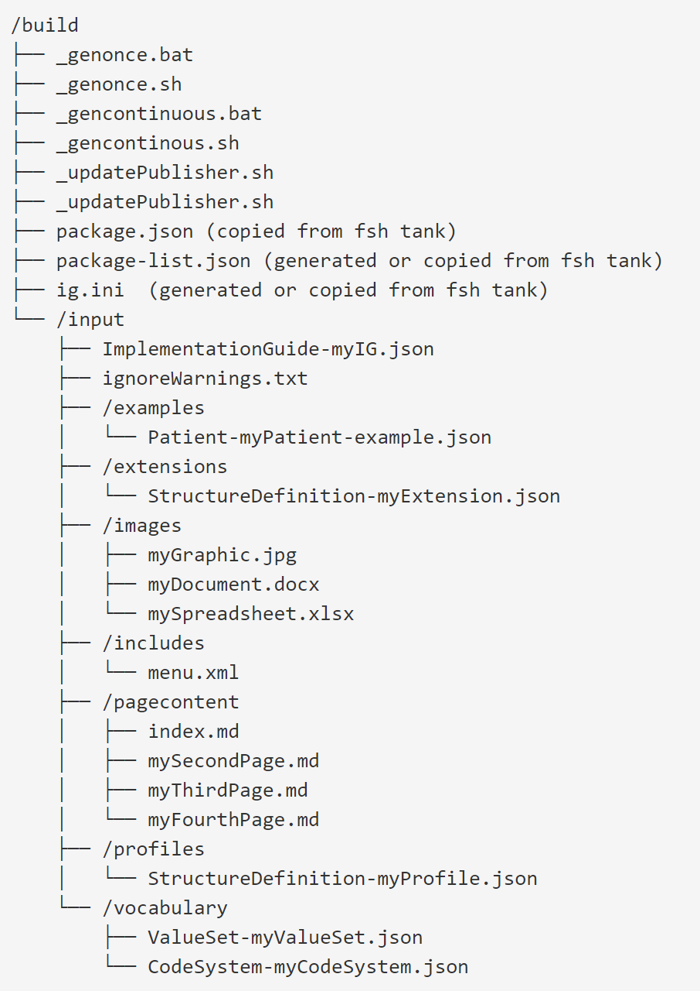
SUSHI Outputs
Default output is /build
Everything is where the IG Publisher expects to find them
The /build/input directory is actually an output of SUSHI, but so named because it is an input to the IG Publisher.

